Slide 1
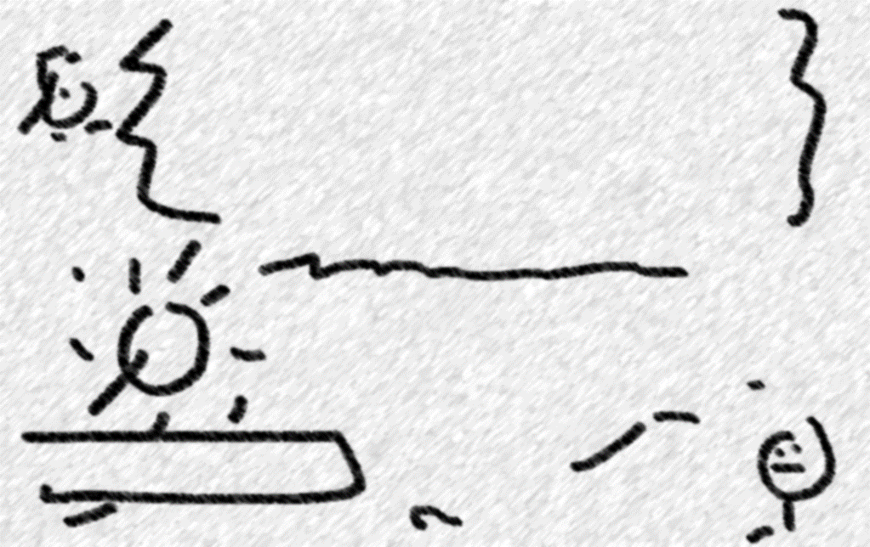
BOYER MOORE STRING MATCHING
Using space and time tradeoff strategy
Hatem Magdi 224813

Slide 2
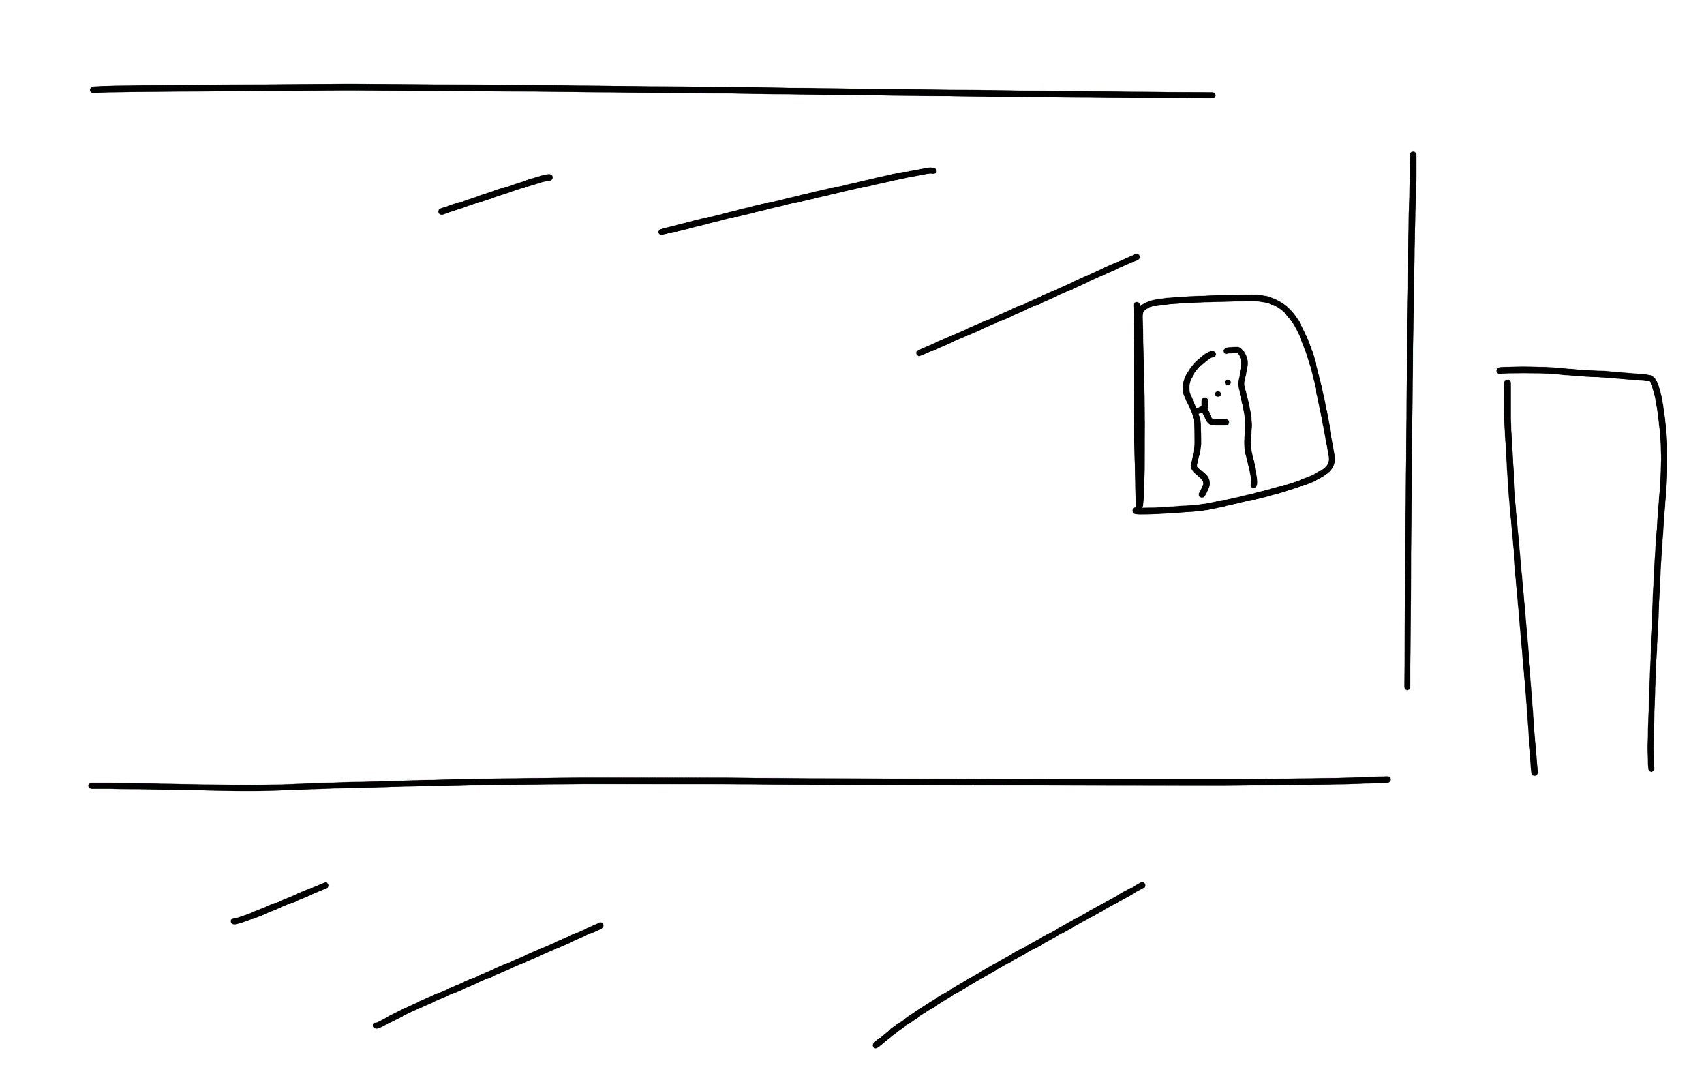





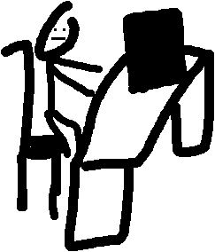



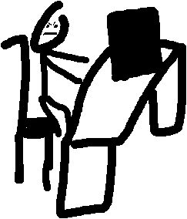
Can I check for the name “CARLOS JOSE”
Hmmmm….
Y ARE Y TAKING SOOO LOOOOOOOONG!!!!!!!!!
Hmmmmmm…..
WAIIIIIIIT!!!!!!!!!
Ok give me a sec

Slide 3


SPACE AND TIME TRADEOFF STARTEGY:
A space-time tradeoff strategy refers to the concept of balancing the use of computational resources (space) and processing time in algorithm design.
2 APPROACHES
Time-Optimized Approach
Space-Optimized Approach

Slide 4


BOYER MOORE STRING MATCHING
Boyer-Moore string matching is an algorithm used to find occurrences of a pattern within a text. It works by scanning the text from left to right, comparing characters from the pattern to the corresponding characters in the text. The key idea is to skip as many characters as possible in the text, based on preprocessed information about the pattern.

Slide 5
Key components of the Boyer-Moore algorithm:
Bad character rule:
Good suffix rule:
It skips ahead in the text by aligning the rightmost occurrence of the mismatched character in the pattern with the mismatched character in the text.
It considers the portion of the pattern that has matched successfully and attempts to skip ahead by finding another occurrence of that portion in the pattern.

Slide 6
BAD-SHIFT TABLE
INPUT:
G | T | T | A | T | A | G | C | T | G | A | T | C | G | C | G | G | C | G | T | A | G | C | G | G | C | G | A | A
G= MAX( 1, 9 -0 - 1 )
NO_OF_CHARS = 256
def badCharHeuristic(string, size):
'''
The preprocessing function for
Boyer Moore's bad character heuristic
'''
# Initialize all occurrence as -1
badChar = [-1]*NO_OF_CHARS
# Fill the actual value of last occurrence
for i in range(size):
badChar[ord(string[i])] = i;
# return initialized list
return badChar
T= MAX( 1, 9 -1 - 1 )
A= MAX( 1, 9 -2 - 1 )
PATTERN:
G | T | A | G | C | G | G | C | G
G= MAX( 1, 9 -3 - 1 )
C= MAX( 1, 9 -4 - 1 )
G= MAX( 1, 9 -5 - 1 )
G= MAX( 1, 9 -6 - 1 )
C= MAX( 1, 9 -7 - 1 )
G= MAX( 1, 9 -8 - 1 )
BAD MATCH TABLE:
G | T | A | C | *
6
1
5
7
4
9
1
8
3
2
FORMULA: MAX( 1, LENGTH OF PATTERN-INDEX-1)

Slide 7
GOOD-SUFFIX TABLE
CASE 1:
def preprocess_strong_suffix(shift, bpos, pat, m):
# m is the length of pattern
i = m
j = m + 1
bpos[i] = j
while i > 0:
'''if character at position i-1 is
not equivalent to character at j-1,
then continue searching to right
of the pattern for border '''
while j <= m and pat[i - 1] != pat[j - 1]:
''' the character preceding the occurrence
of t in pattern P is different than the
mismatching character in P, we stop skipping
the occurrences and shift the pattern
from i to j '''
if shift[j] == 0:
shift[j] = j - i
# Update the position of next border
j = bpos[j]
''' p[i-1] matched with p[j-1], border is found.
store the beginning position of border '''
i -= 1
j -= 1
bpos[i] = j
INPUT:
G | T | T | A | T | A | G | C | T | G | A | T | C | G | C | G | G | C | G | T | A | G | C | G | G | C | G | A | A
PATTERN:
G | T | A | G | C | G | G | C | G
CASE 2:
def preprocess_case2(shift, bpos, pat, m):
j = bpos[0]
for i in range(m + 1):
''' set the border position of the first character
of the pattern to all indices in array shift
having shift[i] = 0 '''
if shift[i] == 0:
shift[i] = j
''' suffix becomes shorter than bpos[0],
use the position of next widest border
as value of j '''
if i == j:
j = bpos[j]
K | 1 | 2 | 3 | 4 | 5 | 6 | 7 | 8
PATTERN | GTAGCGGCG | GTAGCGGCG | GTAGCGGCG | GTAGCGGCG | GTAGCGGCG | GTAGCGGCG | GTAGCGGCG | GTAGCGGCG
D2
2
8
3
8
8
8
8
8

Slide 8
INPUT:
G | T | T | A | T | A | G | C | T | G | A | T | C | G | C | G | G | C | G | T | A | G | C | G | G | C | G | A | A
PATTERN:
G | T | A | G | C | G | G | C | G
LETTER | G | T | A | C | *
D1
1
7
6
1
9
K | 1 | 2 | 3 | 4 | 5 | 6 | 7 | 8
PATTERN | GTAGCGGCG | GTAGCGGCG | GTAGCGGCG | GTAGCGGCG | GTAGCGGCG | GTAGCGGCG | GTAGCGGCG | GTAGCGGCG
D2
2
8
3
8
8
8
8
8

Slide 9
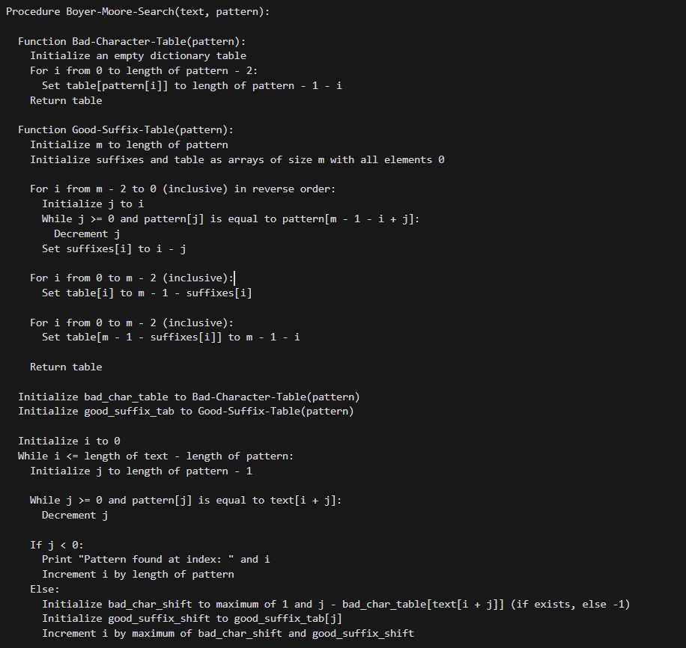
PSEUDOCODE
1. Bad-Character-Table: This function creates a table that maps each character in the pattern to the distance from the rightmost occurrence of the character to the end of the pattern. If a character is not in the pattern, it maps to the length of the pattern. 2. Good-Suffix-Table: This function creates a table that maps each position in the pattern to the next position where a matching suffix starts. It handles two cases: when a substring of the pattern repeats at the end and when a prefix of the suffix is found elsewhere in the pattern. The main procedure, Boyer-Moore-Search, uses these tables to search for the pattern in the text. It starts by aligning the pattern with the text and comparing characters from right to left. If a mismatch is found, it uses the tables to shift the pattern to the right, skipping over the mismatched character in the text. The shift is the maximum of the shifts suggested by the bad character and good suffix rules. The algorithm continues this process until it either finds a match or exhausts the text. If a match is found, it prints the starting index of the match in the text and shifts the pattern past the matched section to continue the search.

Slide 10
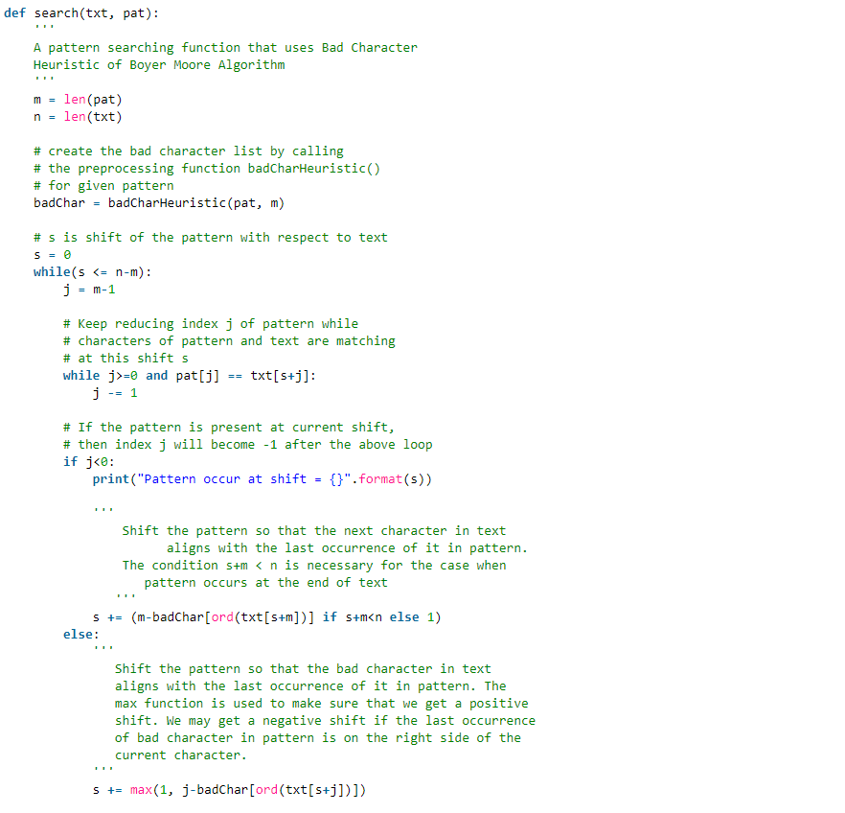
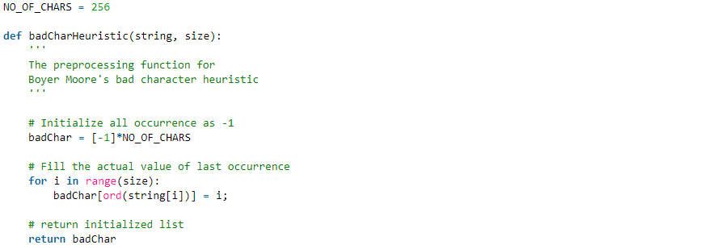


$$\sum_{0}^{n}{1}=O\left(n\right)$$
$$\sum_{0}^{M}{1}=O(m)$$
BAD-SHIFT TABLE ANALYSIS

Slide 11
TIME COMPLEXITY BS-TABLE
BS – COMPLEXITY: O(n)
Search COMPLEXITY: O(m)
T(n,m) = O(m) + O(n)
T(n,m) = O(n) , n>m

Slide 12
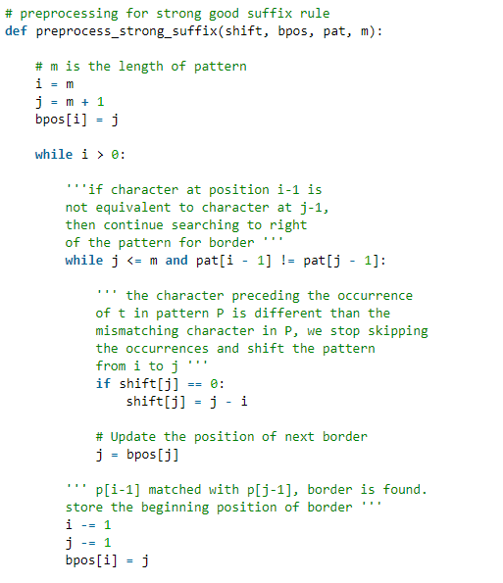
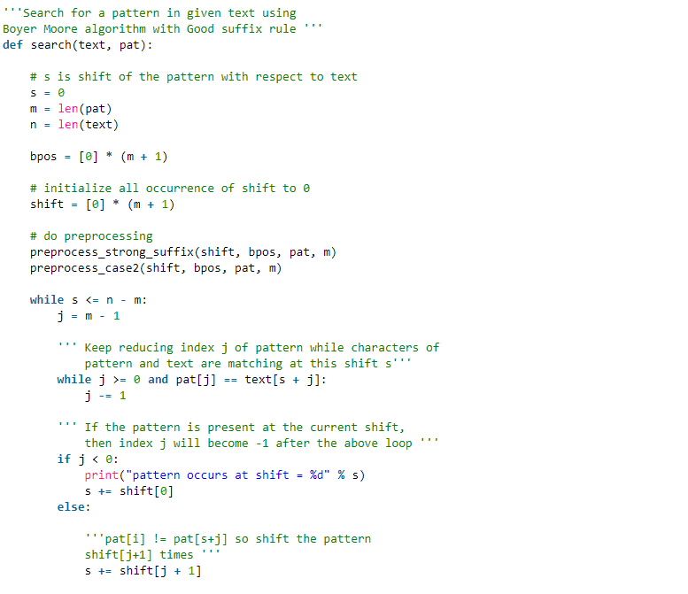
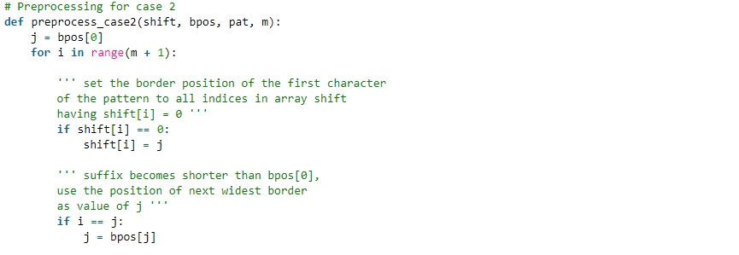

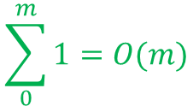

$$\sum_{0}^{m}{\sum_{0}^{n}{1=O(m∗n)}}$$
$$\sum_{0}^{n}{\sum_{0}^{m}{1=O(m∗n)}}$$
$$\sum_{0}^{m}{1=O(m)}$$
GOOD-SUFFIX TABLE ANALYSIS

Slide 13
GOOD SUFFIX TIME COMPLEXITY
GS1 – COMPLEXITY: O(n*m)
GS2 – COMPLEXITY: O(m)
Search COMPLEXITY: O(n*m)
T(n,m) = O(m*n) + O(m)+O(n*m)
T(n,m) = O(m*n)

Slide 14
THANKS FOR LISTENING

